Slide 1
What Do FREP Riparian Results Mean to Fish & Fish Habitat at the Watershed Level?
Acknowledgements
Dr. Peter Tschaplinski, MOE
Doug Lewis, Eric Valdal, CEA Team, MOE
Dr. John Rex and Lisa Nordin, MFLNRO

Slide 2
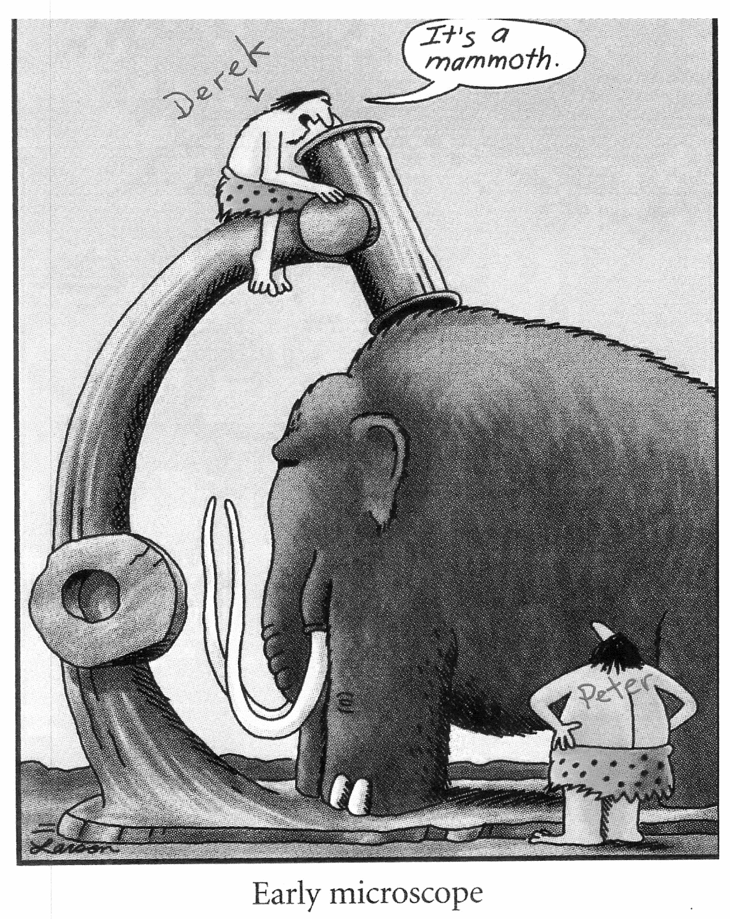
Small Stream Impacts
It’s a Big Job To Assess and Report On
It’s also a Big Problem
It’s easy to get distracted by details

Slide 3
My Job
1) To help FREP assess the condition of streams in and beside 2+ year old cut blocks (protocol, training, assessments)
2) To determine what specific aspects of logging negatively affect streams and how to mitigate them
3) To describe the potential implications of FREP results to fish and fish habitat at the watershed scale

Slide 4
Not My Job
To make recommendations for protecting fish habitat that also takes into account:
1) other social or economic issues
2) the timber supply (the “THLB”)
3) the rate of cut (the “AAC”)

Slide 5
My Talk
What are Implications of FREP Results to Fish & Fish Habitat at the Watershed Scale
1) How many streams in poor condition is too many?
2) How long will it take for streams to recover?
3) What are the implications of poor stream condition and long recovery periods to the sustainability of fish habitat?

Slide 6
Some Basic Truths - a Reminder
1) Small streams are a major driver of physical, chemical and biotic conditions downstream
2) Land use disturbance in upstream reaches often results in impacts to channel morphology and in-stream habitat downstream
3) Numerous reviews conclude there is a need to maintain riparian vegetation and the channel integrity of small streams due to the cumulative effects of changes in temperature, nutrient and sediment delivery downstream

Slide 7
Current Condition of Coastal Streams

Slide 8
How Many Impacted Streams is Too Many?
Bowron River watershed study on 20-30 year old logging (Nordin et al. 2007)
The frequency of FREP “No” answers downstream increased significantly when 30% of the upper stream network was logged to within 10 m

Slide 9
How Many Impacted Streams is Too Many?
Thompson-Okanagan CE Study on 22 Bull Trout Watersheds (Lewis and Valdal 2015)
Stream condition downstream started declining when 15% of stream network upstream was logged to within 30 m of stream edge
Probability of streams downstream in PFC was less than 1 in 5 when 35% of upper watersheds were logged to within 30 m of stream edge

Slide 10
How Many Impacted Streams is Too Many?
East Kootenay West Slope Cutthroat Trout Study (Valdal 2006, Valdal and Quinn 2010)
Significant impact to fish abundance observed when 5-10% of all stream length (fish and non-fish) was logged (old and new) to stream edge, down to 1-5% when just newly logged non-fish streams are considered
Study concluded logging non-fish bearing perennial and ephemeral streams had significant negative effects on resident fish abundance downstream

Slide 11
How Long to Recovery?
Streams affected by mass wasting still show poor habitat conditions and low fish numbers after 100+ years
Moderate size intensively logged streams (e.g. Carnation Creek) also very slow to recover, and can show significant new additional impacts to fish & fish habitat many years after logging is completed and initial impacts documented
Time to complete recovery anticipated to approximate time to re-establish mature/old forest conditions

Slide 12
Bowron River Study Findings Show:
Harvest related impacts to streams were still evident 20-30 years after harvesting
Anticipated impacts to shade, bare ground and disturbed ground especially would need much more than 30 years to recover

Slide 13
FREP Survey Findings Show:
Old logging impacts often still evident in small streams logged to stream edge >60 years ago
Additional impacts to banks and channels that developed later also became more evident when forest canopy eventually covered the streams
Without additional management, we anticipate complete recovery of small streams logged to stream edge will approximate time to re-establish mature/old forest conditions

Slide 14
Implications at the Watershed Scale
Poor condition of 5-35% of upper stream network appears to be all that is required before impacts to fish & fish habitat downstream are evident
If recovery times exceed the rotation period before upper areas are logged again, then we can anticipate even more impacts to fish & fish habitat downstream
With no changes to the THLB in watersheds >35% logged, AAC may need to be adjusted downwards to allow sufficient time for streams to recover
With no adjustments to THLB or AAC in watersheds >35% logged, then expectations of sustainable fish habitat probably need to be adjusted downward
FREP results and other research studies indicate small streams warrant more protection, better retention strategies and/or different harvest strategies at the stream and watershed level

Slide 15
Thank You for Listening
Questions?

Slide 16
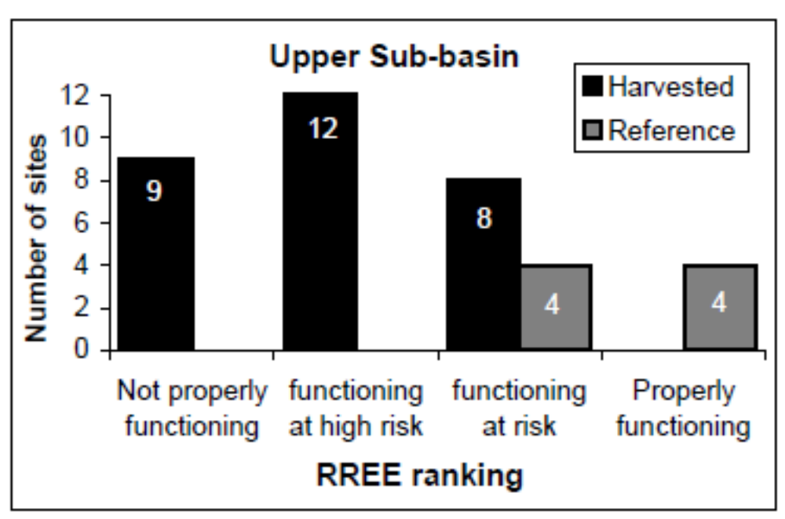
Bowron River Watershed Study
72% of upper watershed In-block stream reaches in poor condition
Average buffer width 3 m

Slide 17
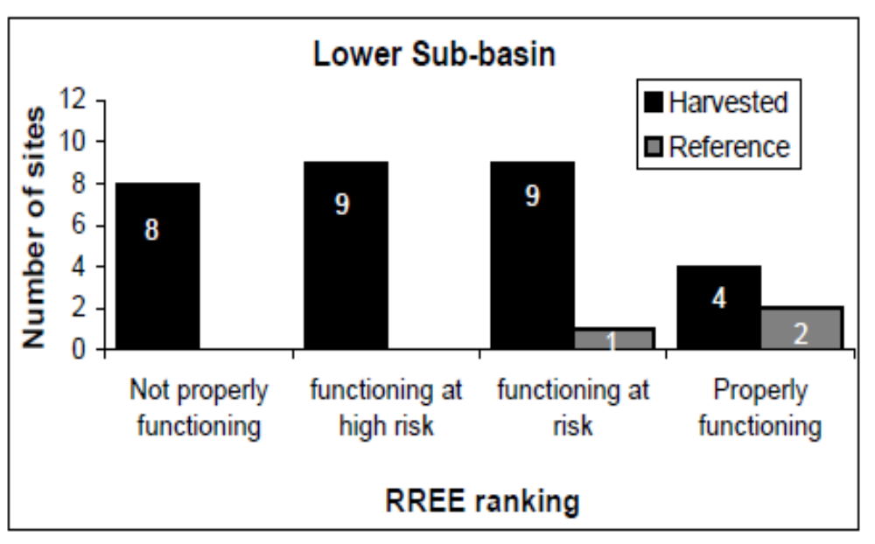
Bowron River Watershed Study
57% of lower watershed In-block stream reaches in poor condition
Average buffer width 23 m

Slide 18
